Slide 1
Azure DevOps Tools
David Benedic

Slide 2
Agenda
What is DevOps?
Azure Resource Manager
Monitoring

Slide 3
What is DevOps?

Slide 4
Azure Resource Manager

Slide 5



Azure Resource Manager (ARM)
This slide could use build/animation. It builds from top to bottom. Azure/Commandline/Visual studio all hit the API to interact with resource manager groups which in turn interact with the different rest points. The link https://azure.microsoft.com/en-us/documentation/articles/virtual-machines-azure-resource-manager-architecture/
explains what this slide is supposed to get across.
RESOURCE MANAGER
Consistent management layer
Tools
SERVICE MANAGEMENT API
Microsoft Azure
Command line
Visual Studio
ADFS
AAD
Contoso
Curated extensions
Cloud
On-premises
RESOURCE PROVIDER CONRACT
Provider rest points
DB

Slide 6
Azure Resource Manager templates
ARM template
ARM templates can:
Simplify deployment
Simplify roll-back
Provide cross-resource configuration and update support
Be used as a learning tool to build to suit
Azure templates are:
Source code, checked-in
Specifies resources and dependencies (VMs, websites, DBs) and connections (configuration, LB sets)
Configurable parameters for input/output
SQL-A website
Repeatable configuration
Configuration→ Resource Group
[SQL CONFIG] VM (2x)
Depends on SQL
Depends on SQL
DEPENDS ON SQL
SQL-A
Website
Virtual Machines
DB
SQL configuration

Slide 7
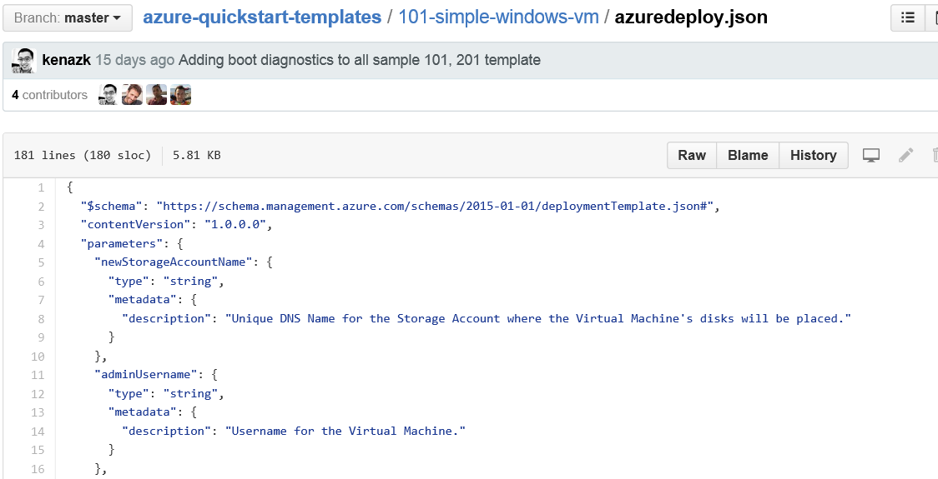
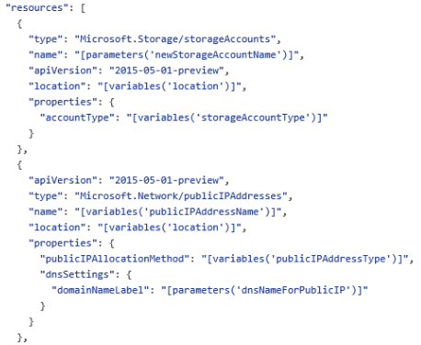
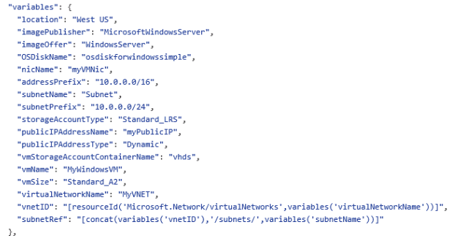
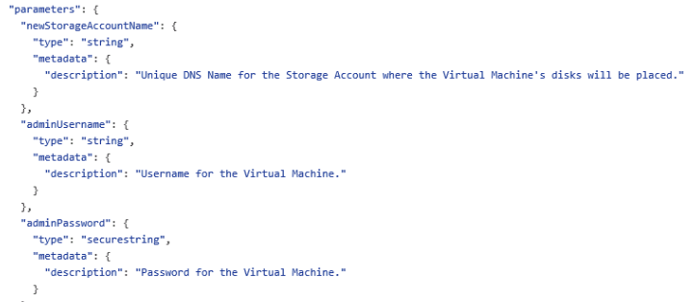
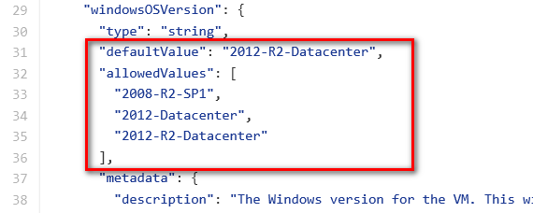
JSON files—simpler than they look Schema, content version, parameters, variables, resources, and outputs

Slide 8
Monitoring

Slide 9
Monitoring

Slide 10
OMS

